Slide 1
Family Micrococcaceae
Genera: Micrococcus, Staphylococcus, & Rothia are catalase positive.
The genera: Streptococcus & enterococcus are catalase negative. Staphylococci are the most commonly isolated micrococcaceae from veterinary clinical specimens.
G+ bacteria. It usually arranged in grape-like clusters. Single or pairs may also found. Colonies are white to gray, and sometimes golden yellow, entire and smooth surface.
They grow readily on many types of media. Some are normal flora of the skin and mucous membrane of human. Other causes suppuration, abscesses formation and a variety of pyogenic infections and even fatal . The main 3 species of staphylococci are:
Staphylococcus aureus
Staphylococcus epidermidis (albus)
Staphylococcus saprophyticus

Slide 2
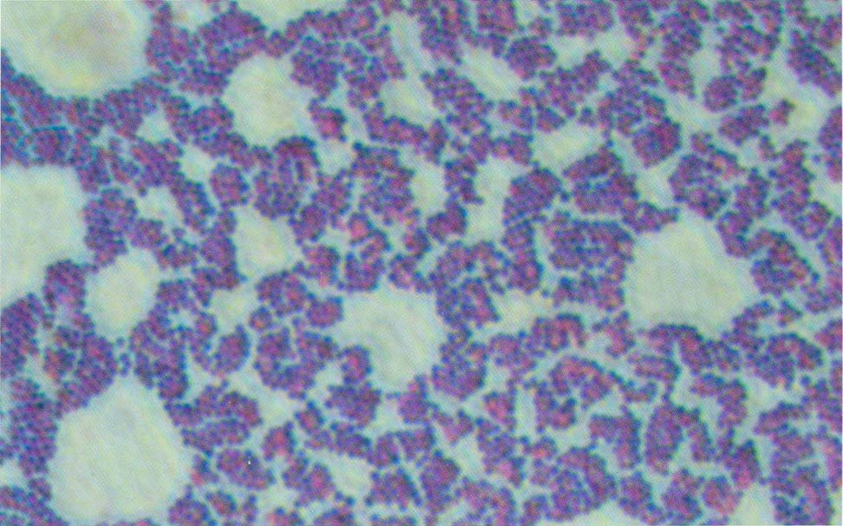
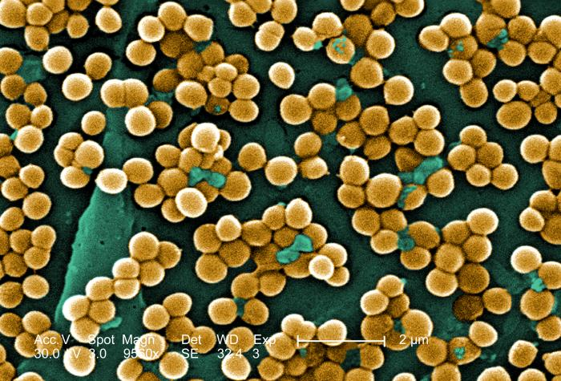
Staphylococci G+ stain

Slide 3
Staphylococci
S. aureus is coagulase positive which differentiate them from other species. It is the major pathogen for human. The coagulase negative staphylococci are normal flora and occasionally causing infection in human (Opportunistic pathogen).
Morphology:
Staphylococci are spherical in shape usually arranged in clusters.
Culture:
They readily grow on different media under aerobic or microerophilic conditions. Colonies on solid media are round smooth and glistening. S. aureus only produce gray to deep golden yellow colonies. S. epidermidis produce gray to white colonies. Staphylococci are catalase positive which differentiate them from streptococci.

Slide 4
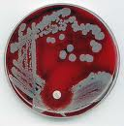
S.aureus on blood agar

Slide 5
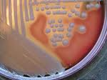
B-hemolysis

Slide 6
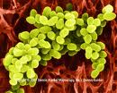
S. aureus in the Gram stain

Slide 7
Pathogenesis
Nasal carriage among normal healthy population occurs in 40%-50% of humans. Nasal carriage in children is higher than in adults. While the rate of skin carriage was about 20%.
10% of normal non-pregnant women carries S. aureus in their vagina. S. aureus can enter to the body through a number of routes (mouth, nose, vagina, wounds, burns …etc).
It can establish a variety of pyogenic infections as well as food intoxication.
The pathogenic capacity of S. aureus is aided by toxins and enzymes they produced together with the invasive properties of the bacteria and their ability to resist a wide range of antibiotics.
Antimicrobial resistance is chromosomal & plasmid mediated.

Slide 8
Pathogenicity factors of S. aureus
S. aureus has three features that make it distinct among most other clinically important bacteria. It can express a variety of virulence factors. It has the ability to develop and expand resistance to a broad spectrum of antimicrobial drug classes, and its wide distribution in human, animal and environment.

Slide 9
Toxins and enzymes of S. aureus
Staphylococci can produce many extracellular enzymes and toxins. These substances enable the bacteria for multiplying and spread widely in the tissues.
1-Catalase: which convert hydrogen peroxide into water and oxygen.
2-Coagulase: May deposit fibrin on the surface of staphylococci and thus protect them from phagocytosis.
3- Enterotoxin: It is a heat-stable toxin responsible for food intoxication of S. aureus.
4-Exotoxins: which includes leukocidin, exfoliative toxin and toxic shock syndrome.

Slide 10
Enzymes and toxins of S. aureus
Capsule: inhibit phagocytosis, Promote adherence
Piptidoglycan: leukocyte chemoatractant, decomplementation
Toxins: Antiphagocytic, cytotoxic
Exfoliative toxin: split cellular bridges
Enterotoxin: nauseogenic, diarrheagenic
TSST: endothelial damage
Coagulase: Convert fibrinogen into fibrin
Hyaluronidase: Hydrolyzes hyaluronic acid in connective tissues
Lipase: hydrolyzes lipids
Nuclease: Hydrolyzes DNA

Slide 11
Another pathogenicity factors
B-lactamase production: The majority of S. aureus isolates produce the B-lactamase enzyme which break down the B-lactam ring, & thus it is responsible for the resistance of S. aureus against penicillins & cephalosporines
Biofilm formation: A biofilm is an aggregate of microbes in which cells adhere to each other and/or to a surface. These adherent cells are frequently embedded within a self-produced matrix of extracellular polymeric substance. Biofilm protect the microbe from the immune response & increase the antimicrobial resistance. High percentage of S. aures are biofilm former

Slide 12
S. aureus food intoxication:
Food poisoning due to S. aureus enterotoxin is characterized by a short incubation period (1-8 hrs), violent nausea, vomiting and diarrhea. There is no fever. The enterotoxin is heat-stable (resist boiling for 30 minutes)and resistant to the action of Gut enzymes. The emetic effect of enterotoxin is probably result from CNS stimulation (vomiting center).

Slide 13
Toxic shock syndrome:
Most strains of S. aureus isolated from patients with toxic shock syndrome produced a toxin called toxic shock syndrome toxin (TSST). In human the toxin is associated with fever, shock and multisystem involvement, including desquamative skin rash.

Slide 14
Laboratory diagnosis:
1.Specimens: Pus, blood, urine, sputum, CSF, wound swab, burn swab, seminal fluid, vaginal secretion and so on
2. Smears: To see the typical appearance of the bacteria.
3. Culture: On blood agar plates to identify bacterial colonies and differentiate them through:
Coagulase test.
Catalase test.
Biochemical tests.
Culture on special media e.g. Mannitol salt agar (with 6.5% NaCl) to differentiate S. aureus than other staphylococci

Slide 15
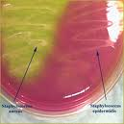
Mannitol salt agar

Slide 16
Slide & tube coagulase test

Slide 17
Epidemiology
S. aureus is widely distributed in the nature and causing a wide range of pyogenic infections. Furthermore it is responsible for community acquired as well as nosocomial infections ( Hospital infections particularly among immuno-compromised patients ) due to its wide distribution in hospital settings including health care workers. On the other hand, S. aureus is one of the well-known bacteria that develop multiple antibiotic resistance.

Slide 18
Methicillin resistant S. aureus (MRSA)
According to its susceptibility to Methicillin, S. aureus was divided into:
Methicillin resistant (MRSA): which is highly prevalent in the community causing a wide range of infection including community acquired (CA-MRSA) pneumonia . Beside that it is highly distributed in the hospitals (Hospital environment and fomites HA-MRSA) causing infections among patients.
MRSA isolates usually multi-drug resistant
High prevalence of MRSA was found among HCWs
2. Methicillin senstive S. aureus (MSSA)

Slide 19
Infections in human
Skin & soft tissue infection (impetigo in children)
Upper & lower respiratory tract infection
Urinary & genital tract infections
Food intoxication
Bone & joint infections
Septicemia
Eye infection
CNS infections
Nosocomial infections
Burn infections

Slide 20
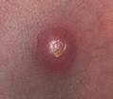
Clinical picture of S. aureus infections

Slide 21
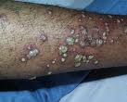
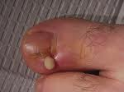
Clinical picture of S.aureus

Slide 22
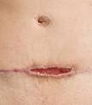
Clinical picture of S. aureus

Slide 23
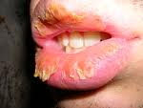
Exfoliative skin infection

Slide 24
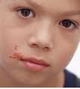
Impetigo

Slide 25
Veterinary importance
S. aureus: causes wound infection in all animals, mastitis, skin infections, joint infection especially in chickens, diarrhea in pits birds, vaginal infection in dogs & horses.
S. epidermidis: It is OP, causes bovine mastitis, skin abscesses in other animals.
S. saprophyticus: It is OP in urinary tract infections.
S. warneri: it causes septicemia in lovebirds.

Slide 26
Bumblefood in chicken Mastitis in cow

